Slide 1
Query Processing
Module 2

Slide 2
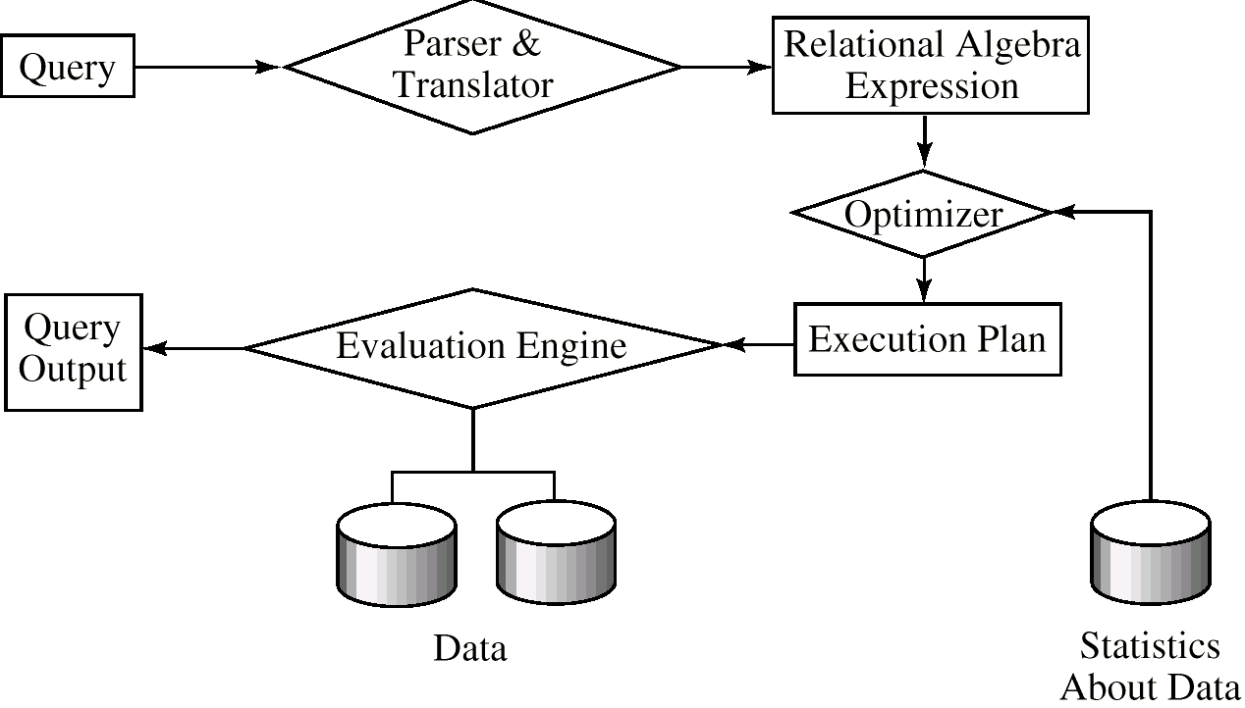
Basic Steps in Query Processing
1. Parsing and translation
2. Optimization
3. Evaluation

Slide 3
Basic Steps in Query Processing (Cont.)
Parsing and translation
translate the query into its internal form. This is then translated into relational algebra.
Parser checks syntax, verifies relations
Evaluation
The query-execution engine takes a query-evaluation plan, executes that plan, and returns the answers to the query.

Slide 4
Basic Steps in Query Processing
Optimization – finding the cheapest evaluation plan for a query.
Given relational algebra expression may have many equivalent expressions E.g., _{σbalance<2500}(∏_{balance}(account)) is equivalent to ∏_{balance}(_{σbalance<2500}(account))
Any relational-algebra expression can be evaluated in many ways. Annotated expression specifying detailed evaluation strategy is called an evaluation-plan. E.g., can use an index on balance to find accounts with balance < 2500, or can perform complete relation scan and discard accounts with balance ≥ 2500
Amongst all equivalent expressions, try to choose the one with cheapest possible evaluation plan. Cost DBMS catalog.

Slide 5
Catalog Information for Cost Estimation
n_{r}: number of tuples in a relation r.
b_{r}: number of blocks containing tuples of r.
s_{r}: size of a tuple of r.
f_{r}: blocking factor of r — i.e., the number of tuples of r that fit into one block.
V(A, r): number of distinct values that appear in r for attribute A; same as the size of ∏_{A}(r).
SC(A, r): selection cardinality of attribute A of relation r; average number of records that satisfy equality on A.
If tuples of r are stored together physically in a file, then:

Slide 6
Catalog Information about Indices
f_{i}: average fan-out of internal nodes of index i, for tree-structured indices such as B+-trees.
HT_{i}: number of levels in index i — i.e., the height of i.
For a balanced tree index (such as B+-tree) on attribute A of relation r, HT_{i} = ⎡log₁,(V(A,r)⎤.
For a hash index, HT_{i} is 1.
LB_{i}: number of lowest-level index blocks in i — i.e, the number of blocks at the leaf level of the index.

Slide 7
Measures of Query Cost
Many possible ways to estimate cost, for instance disk accesses, CPU time, or even communication overhead in a distributed or parallel system.
Typically disk access is the predominant cost, and is also relatively easy to estimate. Therefore number of block transfers from disk is used as a measure of the actual cost of evaluation. It is assumed that all transfers of blocks have the same cost.
Costs of algorithms depend on the size of the buffer in main memory, as having more memory reduces need for disk access. Thus memory size should be a parameter while estimating cost; often use worst case estimates.
We refer to the cost estimate of algorithm A as E_{A}, We do not include cost to writing output to disk.

Slide 8
Selection Operation
File scan – search algorithms that locate and retrieve records that fulfill a selection condition.
Algorithm A1 (linear search). Scan each file block and test all records to see whether they satisfy the selection condition.
Cost estimate (number of disk blocks scanned) E_{A1} = b_{r}
If selection is on a key attribute E_{A1} = (b_{r}/2) (stop on finding record)
Linear search can be applied regardless of
selection condition or
ordering of records in the file, or
availability of indices

Slide 9
Selection Operation (Cont.)
A2 (binary search). Applicable if selection is an equality comparison on the attribute on which file is ordered.
Assume that the blocks of a relation are stored contiguously
Cost estimate (number of disk blocks to be scanned):
⎡log₂(b_{r})⎤ — cost of locating the first tuple by a binary search on the blocks
SC(A, r) — number of records that will satisfy the selection
⎡SC(A, r)/f_{r}⎤ — number of blocks that these records will occupy
Equality condition on a key attribute: SC(A,r) = 1; estimate reduces to E_{A2} = ⎡log₂(b_{r})⎤

Slide 10
Statistical Information for Examples
f_{account}= 20 (20 tuples of account fit in one block)
V(branch-name, account) = 50 (50 branches)
V(balance, account) = 500 (500 different balance values)
π_{account} = 10000 (account has 10,000 tuples)
Assume the following indices exist on account:
A primary, B⁺-tree index for attribute branch-name
A secondary, B⁺-tree index for attribute balance

Slide 11
Selection Cost Estimate Example
σ_{branch-name = “Perryridge”}(account)
Number of blocks is b_{account} = 500: 10,000 tuples in the relation; each block holds 20 tuples.
Assume account is sorted on branch-name.
V(branch-name,account) is 50
10000/50 = 200 tuples of the account relation pertain to Perryridge branch
200/20 = 10 blocks for these tuples
A binary search to find the first record would take ⎡log₂(500)⎤ = 9 block accesses
Total cost of binary search is 9 + 10 -1 = 18 block accesses (versus 500 for linear scan)

Slide 12
Selections Using Indices
Index scan – search algorithms that use an index; condition is on search-key of index.
A3 (primary index on candidate key, equality). Retrieve a single record that satisfies the corresponding equality condition E_{A3} = HT_{i} + 1
A4 (primary index on nonkey, equality) Retrieve multiple records. Let the search-key attribute be A.
A5 (equality on search-key of secondary index).
Retrieve a single record if the search-key is a candidate key E_{A5} = HT_{i} + 1
Retrieve multiple records (each may be on a different block) if the search-key is not a candidate key. E_{A3} = HT_{i} + SC(A,r)

Slide 13
Cost Estimate Example (Indices)
Consider the query is σ_{branch-name = “Perryridge”}(account), with the primary index on branch-name.
Since V(branch-name, account) = 50, we expect that 10000/50 = 200 tuples of the account relation pertain to the Perryridge branch.
Since the index is a clustering index, 200/20 = 10 block reads are required to read the account tuples.
Several index blocks must also be read. If B⁺-tree index stores 20 pointers per node, then the B⁺-tree index must have between 3 and 5 leaf nodes and the entire tree has a depth of 2. Therefore, 2 index blocks must be read.
This strategy requires 12 total block reads.

Slide 14
Selections Involving Comparisons
Implement selections of the form σ_{A≤V}(r) or σ_{A ≥ V}(r) by using a linear file scan or binary search, or by using indices in the following ways:
A6 (primary index, comparison). The cost estimate is: where c is the estimated number of tuples satisfying the condition. In absence of statistical information c is assumed to be n_{r}/2.
A7 (secondary index, comparison). The cost estimate:
where c is defined as before. (Linear file scan may be cheaper if c is large!).

Slide 15
Implementation of Complex Selections
The selectivity of a condition _{i} is the probability that a tuple in the relation r satisfies _{i} . If s_{i} is the number of satisfying tuples in r, _{i} ‘s selectivity is given by s_{i} /n_{r}.
Conjunction: _{1}∧ _{2}∧. . . _{n}∧(r). The estimate for number of tuples in the result is:
Disjunction: _{1}∨ _{2} ∨. . . _{n} ∨(r). Estimated number of tuples:
Negation: _{¬θ(}(r. Estimated number of tuples: n_{r} – size(σ_{θ}(r))

Slide 16
Algorithms for Complex Selections
A8 (conjunctive selection using one index). Select a combination of _{i} and algorithms A1 through A7 that results in the least cost for _{1}(r). Test other conditions in memory buffer.
A9 (conjunctive selection using multiple-key index). Use appropriate composite (multiple-key) index if available.
A10 (conjunctive selection by intersection of identifiers). Requires indices with record pointers. Use corresponding index for each condition, and take intersection of all the obtained sets of record pointers. Then read file. If some conditions did not have appropriate indices, apply test in memory.
A11 (disjunctive selection by union of identifiers). Applicable if all conditions have available indices. Otherwise use linear scan.

Slide 17
Example of Cost Estimate for Complex Selection
Consider a selection on account with the following condition: where branch-name = “Perryridge” and balance = 1200
Consider using algorithm A8:
The branch-name index is clustering, and if we use it the cost estimate is 12 block reads (as we saw before).
The balance index is non-clustering, and V(balance, account = 500, so the selection would retrieve 10,000/500 = 20 accounts. Adding the index block reads, gives a cost estimate of 22 block reads.
Thus using branch-name index is preferable, even though its condition is less selective.
If both indices were non-clustering, it would be preferable to use the balance index.

Slide 18
Example (Cont.)
Consider using algorithm A10:
Use the index on balance to retrieve set S₁ of pointers to records with balance = 1200.
Use index on branch-name to retrieve-set S₂ of pointers to records with branch-name = Perryridge”.
S₁ ∩ S₂ = set of pointers to records with branch-name = “Perryridge” and balance = 1200.
The number of pointers retrieved (20 and 200), fit into a single leaf page; we read four index blocks to retrieve the two sets of pointers and compute their intersection.
Estimate that one tuple in 50 * 500 meets both conditions. Since n_{account} = 10000, conservatively overestimate that S₁ ∩ S₂ contains one pointer.
The total estimated cost of this strategy is five block reads.

Slide 19
Sorting
We may build an index on the relation, and then use the index to read the relation in sorted order. May lead to one disk block access for each tuple.
For relations that fit in memory, techniques like quicksort can be used. For relations that don’t fit in memory, external sort-merge is a good choice.

Slide 20
External Sort-Merge
Let M denote memory size (in pages).
1. Create sorted runs as follows. Let i be 0 initially. Repeatedly do the following till the end of the relation:
(a) Read M blocks of relation into memory
(b) Sort the in-memory blocks
(c) Write sorted data to run R_{i}; increment i.
2. Merge the runs; suppose for now that i < M. In a single merge step, use i blocks of memory to buffer input runs, and 1 block to buffer output. Repeatedly do the following until all input buffer pages are empty:
(a) Select the first record in sort order from each of the buffers
(b) Write the record to the output
(c) Delete the record from the buffer page; if the buffer page is empty, read the next block (if any) of the run into the buffer.

Slide 21
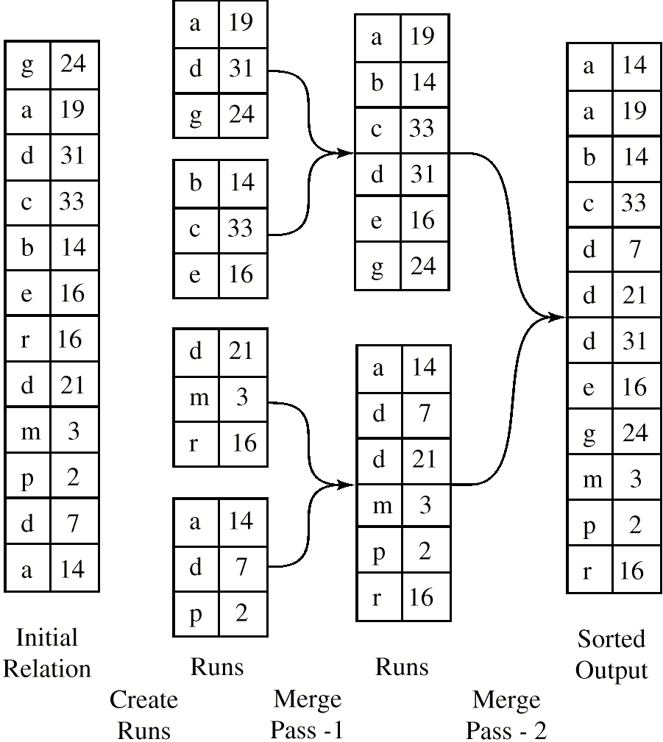
Example: External Sorting Using Sort-Merge

Slide 22
External Sort-Merge (Cont.)
If i ≥ M, several merge passes are required.
In each pass, contiguous groups of M - 1 runs are merged.
A pass reduces the number of runs by a factor of M -1, and creates runs longer by the same factor.
Repeated passes are performed till all runs have been merged into one.
Cost analysis:
Disk accesses for initial run creation as well as in each pass is 2b_{r} (except for final pass, which doesn’t write out results)
Total number of merge passes required: ⎡log_{M–1}(b_{r}/M)⎤.
Thus total number of disk accesses for external sorting:
b_{r}(2 ⎡log_{M–1}(b_{r}/M)⎤ + 1)

Slide 23
Join Operation
Several different algorithms to implement joins
Nested-loop join
Block nested-loop join
Indexed nested-loop join
Merge-join
Hash-join
Choice based on cost estimate
Join size estimates required, particularly for cost estimates for outer-level operations in a relational-algebra expression.

Slide 24
Join Operation: Running Example
Running example: depositor |x| customer
Catalog information for join examples:
n_{customer} = 10,000.
f_{customer} = 25, which implies that b_{customer} 10000/25 = 400.
n_{depositor} = 5000.
f_{depositor} = 50, which implies that b_{depositor} = 5000/50 = 100.
V(customer-name, depositor) = 2500, which implies that , on average, each customer has two accounts.
Also assume that customer-name in depositor is a foreign key on customer.

Slide 25
Estimation of the Size of Joins
The Cartesian product r x s contains n_{r}n_{s} tuples; each tuple occupies s_{r} + s_{s} bytes.
If R ∩ S = ∅, then r s is the same as r x s.
If R ∩ S is a key for R, then a tuple of s will join with at most one tuple from r; therefore, the number of tuples in r s is no greater than the number of tuples in s. If R ∩ S in S is a foreign key in S referencing R, then the number of tuples in r s is exactly the same as the number of tuples in s. The case for R ∩ S being a foreign key referencing S is symmetric.
In the example query depositor customer, customer-name in depositor is a foreign key of customer; hence, the result has exactly n_{depositor} tuples, which is 5000

Slide 26
Estimation of the Size of Joins (Cont.)
If R ∩ S = {A} is not a key for R or S. If we assume that every tuple t in R produces tuples in R number of tuples in R S is estimated to be: If the reverse is true, the estimate obtained will be: The lower of these two estimates is probably the more accurate one.

Slide 27
Estimation of the Size of Joins (Cont.)
Compute the size estimates for depositor customer without using information about foreign keys:
V(customer-name, depositor) = 2500, and V(customer-name, customer) = 10000
The two estimates are 5000 * 10000/2500 - 20,000 and 5000 * 10000/10000 = 5000
We choose the lower estimate, which in this case, is the same as our earlier computation using foreign keys.

Slide 28
Nested-Loop Join
Complete the theta join r _{Θ} s for each tuple t_{r} in r do begin for each tuple t_{s} in s do begin test pair (t_{r},t_{s}) to see if they satisfy the join condition  if they do, add t_{r} • t_{s} to the result. end end
r is called the outer relation an ds the inner relation of the join.
Requires no indices and can be used with any kind of join condition.
Expensive since it examines every pair of tuples in the two relations. If the smaller relation fits entirely in main memory, use that relation as the inner relation.

Slide 29
Nested-Loop Join (Cont.)
In the worst case, if there is enough memory only to hold one block of each relation, the estimated cost is n_{r} ∗ b_{s} + b_{r} disk accesses.
If the smaller relation fits entirely in memory, use that as the inner relation. This reduces the cost estimate to b_{r} + b_{s} disk accesses.
Assuming the worst case memory availability scenario, cost estimate will be 5000 ∗ 400 + 100 = 2,000,100 disk accesses with depositor as outer relation, and 1000 ∗ 100 + 400 = 1,000,400 disk accesses with customer as the outer relation.
If smaller relation (depositor) fits entirely in memory, the cost estimate will be 500 disk accesses.
Block nested-loops algorithm (next slide is preferable.

Slide 30
Block Nested-Loop Join
Variant of nested-loop join in which every block of inner relation is paired with every block of outer relation.
for each block B_{r} of r do begin for each block B_{s} of s do begin for each tuple t_{r} in B_{r} do begin for each tuple t_{s} in B_{s} do begin test pair (t_{r},t_{s}) for satisfying the join condition if they do, add t_{r} • t_{s} to the result. end end end end
Worst case: each block in the inner relation s is read only once for each block in the outer relation (instead of once for each tuple in the outer relation

Slide 31
Block Nested-Loop Join (Cont.)
Worst case estimate: b_{r} ∗ b_{s} + b_{r} block accesses. Best case: b_{r} + b_{s} block accesses.
Improvements to nested loop and block nested loop algorithms:
If equi-join attribute forms a key or inner relation, stop inner loop with first match
In block nested-loop, use M — 2 disk blocks as blocking unit for outer relations, where M = memory size in blocks; use remaining two blocks to buffer inner relation and output. Reduces number of scans of inner relation greatly.
Scan inner loop forward and backward alternately, to make use of the blocks remaining in buffer (with LRU replacement)
Use index on inner relation if available

Slide 32
Indexed Nested-Loop Join
If an index is available on the inner loop’s join attribute and join is an equi-join or natural join, more efficient index lookups can replace file scans.
Can construct an index just to compute a join.
For each tuple t_{r} in the outer relation r, use the index to look up tuples in s that satisfy the join condition with tuple t_{r}.
Worst case: buffer has space for only one page of r, and, for each tuple in r, we perform an index lookup on s.
Cost of the join: b_{r} + n_{r} ∗ c, where c is the cost of a single selection on s using the join condition.
If indices are available on both r and s, use the one with fewer tuples as the outer relation.

Slide 33
Example of Index Nested-Loop Join
Compute depositor customer, with depositor as the outer relation.
Let customer have a primary B⁺-tree index on the join attribute customer-name, which contains 20 entries in each index node.
Since customer has 10,000 tuples, the height of the tree is 4, and one more access is needed to find the actual data.
Since _{depositor} is 5000, the total cost is 100 + 5000 * 5 = 25,100 disk accesses.
This cost is lower than the 40,100 accesses needed for a block nested-loop join.

Slide 34
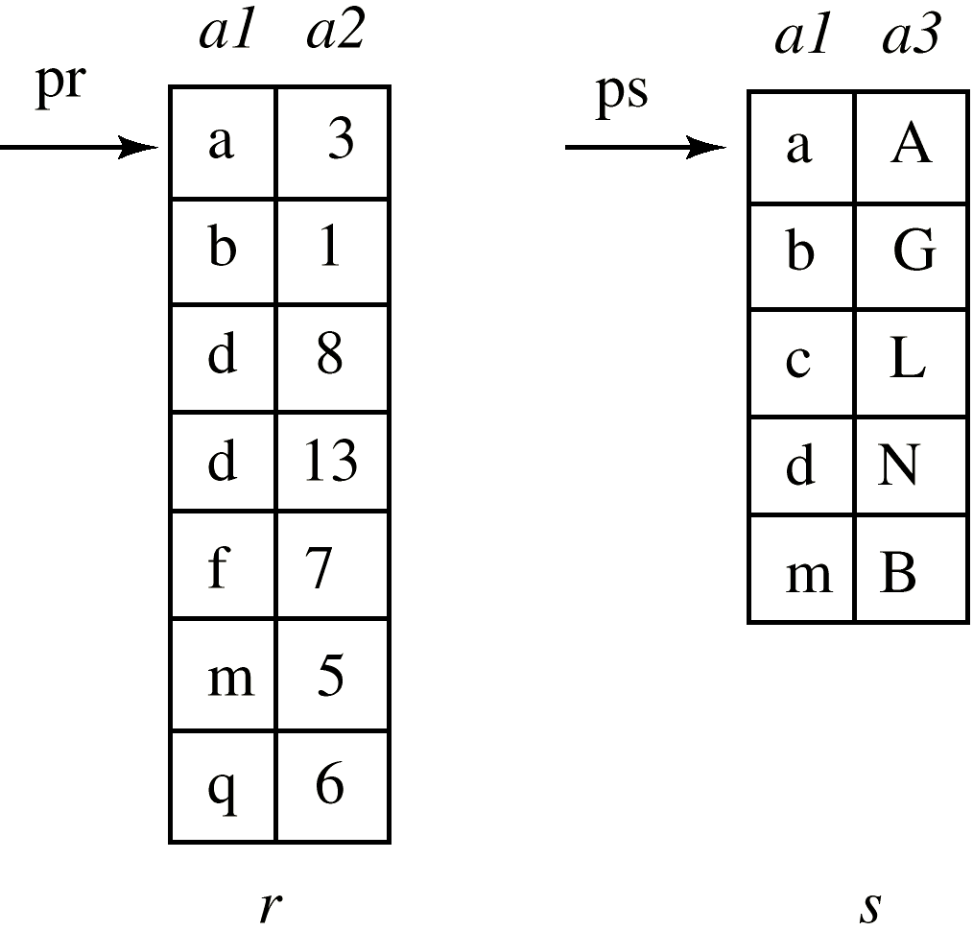
Merge-Join
1. First sort both relations on their join attribute (if not already sorted on the join attributes).
2. Join step is similar to the merge stage of the sort-merge algorithm. Main difference is handling of duplicate values in join attribute — every pair with same value on join attribute must be matched.

Slide 35
Merge-Join (Cont.)
Each tuple needs to be read only once, and as a result, each block is also read only once. Thus number of block accesses is b_{r} + b_{s1}, plus the cost of sorting if relations are unsorted.
Can be used only for equi-joins and natural joins
If one relation is sorted, and the other has a secondary B⁺-tree index on the join attribute, hybrid merge-joins are possible. The sorted relation is merged with the leaf entries of the B⁺-tree . The result is sorted on the addresses of the unsorted relation’s tuples, and then the addresses can be replaced by the actual tuples efficiently.

Slide 36
Hash-Join
Applicable for equi-joins and natural joins.
A hash function h is used to partition tuples of both relations into sets that have the same hash value on the join attributes, as follows:
h maps joinAttrs values to {0, 1, ..., max}, where JoinAttrs denotes the common attributes of r and s used in the natural join.
H_{r0}, H_{r1}, . . ., H_{rmax} denote partitions of r tuples, each initially empty. Each tuple t_{r} ∈ r is put in partition H_{ri}, where i = h(t_{r}[JoinAttrs]).
H_{s0}, H_{s1}, . . ., H_{smax} denotes partitions for s tuples, each initially empty. Each tuple t_{s} ∈s is put in partition H_{s}, where i = h(t_{s}[JoinAttrs]).

Slide 37
Hash-Join (Cont.)
r tuples in H_{ri} need only to be compared with s tuples in any other partition, since:
an r tuple and an s tuple that satisfy the join condition will have the same value for the join attributes.
If that value is hashed to some value i, the r tuple has to be in H_{ri} and the s tuple in H_{si}.

Slide 38
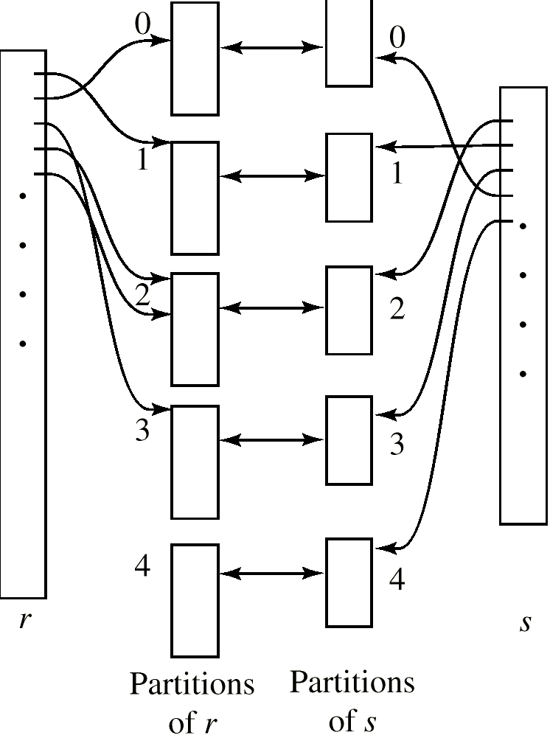
Hash-Join (Cont.)

Slide 39
Hash-Join algorithm
The hash-join of r and s is computed as follows.
1. Partition the relations s using hashing function h. When partitioning a relation, one block of memory is reserved as the output buffer for each partition.
2. Partition r similarly.
3. For each i:
(a) Load H_{si} into memory and build an in-memory hash index on it using the join attribute. This hash index uses a different hash function than the earlier one h.
(b) Read the tuples in H_{ri} from the disk one by one. For each tuple t_{r} locate each matching tuple t_{s} in H_{si} using the in-memory hash index. Output the concatenation of their attributes.
Relation s is called the build input and r is called the probe input.

Slide 40
Hash-Join algorithm (Cont.)
The value max and the hash function h is chosen such athat each H_{si} should fit in memory.
Recursive partitioning required if number of partitions max is greater than number of pages M of memory.
instead of partitioning max ways, partition s M – 1 ways;
Further partition the M – 1 partitions using a different hash function
Use same partitioning method on r
Rarely required: e.g., recursive partitioning not needed for relations of 1GB or less with memory size of 2MB, with block size of 4KB.
Hash-table overflow occurs in partition H_{si} if H_{si} does not fit in memory. Can resolve by further partitioning H_{si} using different hash function. H_{ri} must be similarly partitioned.

Slide 41
Cost of Hash-Join
If recursive partitioning is not required: 3(b_{r} + b_{s}) +2 ∗ max
If recursive partitioning required, number of passes required for partitioning s is ⎡log_{M–1}(b_{s}) – 1⎤. This is because each final partition of s should fit in memory.
The number of partitions of probe relation r is the same as that for build relation s; the number of passes for partitioning of r is also the same as for s. Therefore it is best to choose the smaller relation as the build relations.
Total cost estimate is:
2(b_{r} + b_{s}) ⎡log_{M–1}(b_{s}) – 1⎤ + b_{r} + b_{s}
If the entire build input can be kept in main memory, max can be set to 0 and the algorithm does not partition the relations into temporary files. Cost estimate goes down to b_{r} + b_{s}.

Slide 42
Example of Cost of Hash-Join
customer depositor
Assume that memory size is 20 blocks
b_{depositor} = 100 and b_{customer} = 400.
depositor is to be used as build input. Partition it into five partitions, each of size 20 blocks. This partitioning can be done in one pass.
Similarly, partition customer into five partitions, each of size 80. This is also done in one pass.
Therefore total cost: 3(100 + 400) = 1500 block transfers (ignores cost of writing partially filled blocks).

Slide 43
Hybrid Hash–Join
Useful when memory sized are relatively large, and the build input is bigger than memory.
With memory size of 25 blocks, depositor can be partitioned into five partitions, each of size 20 blocks.
Keep the first of the partitions of the build relation in memory. It occupies 20 blocks; one block is used for input, and one block each is used for buffering the other four partitions.
customer is similarly partitioned into five partitions each of size 80; the first is used right away for probing, instead of being written out and read back in.
Ignoring the cost of writing partially filled blocks, the cost is 3(80 + 320) + 20 +80 = 1300 block transfers with hybrid hash-join, instead of 1500 with plain hash-join.
Hybrid hash-join most useful if M >>

Slide 44
Complex Joins
Join with a conjunctive condition:
r ₁∧ ₂∧... ∧ _{n} s
Compute the result of one of the simpler joins r _{i} s
final result comprises those tuples in the intermediate result that satisfy the remaining conditions
₁ ∧ . . . ∧ _{i –1} ∧ _{i +1} ∧ . . . ∧ _{n}
Test these conditions as tuples in r
r ₁ ∨ ₂ ∨... ∨ _{n} s
Compute as the union of the records in individual joins r _{i} s:
(r ₁ s) ∪ (r ₂ s) ∪ . . . ∪ (r _{n} s)

Slide 45
Complex Joins (Cont.)
Join involving three relations: loan depositor customer
Strategy 1. Compute depositor customer; use result to compute loan (depositor customer)
Strategy 2. Computer loan depositor first, and then join the result with customer.
Strategy 3. Perform the pair of joins at once. Build and index on loan for loan-number, and on customer for customer-name.
For each tuple t in depositor, look up the corresponding tuples in customer and the corresponding tuples in loan.
Each tuple of deposit is examined exactly once.
Strategy 3 combines two operations into one special-purpose operation that is more efficient than implementing two joins of two relations.

Slide 46
Other Operations
Duplicate elimination can be implemented via hashing or sorting.
On sorting duplicates will come adjacent to each other, and all but one set of duplicates can be deleted. Optimization: duplicates can be deleted during run generation as well as at intermediate merge steps in external sort-merge.
Hashing is similar – duplicates will come into the same bucket.
Projection is implemented by performing projection on each tuple followed by duplicate elimination.

Slide 47
Other Operations (Cont.)
Aggregation can be implemented in a manner similar to duplicate elimination.
Sorting or hashing can be used to bring tuples in the same group together, and then the aggregate functions can be applied on each group.
Optimization: combine tuples in the same group during run generation and intermediate merges, by computing partial aggregate values.
Set operations (∪, ∩ and ⎯): can either use variant of merge-join after sorting, or variant of hash-join.

Slide 48
Other Operations (Cont.)
E.g., Set operations using hashing:
1. Partition both relations using the same hash function, thereby creating
2. Process each partition i as follows. Using a different hashing function, build an in-memory hash index on H_{ri} after it is brought into memory.
3. – r ∪ s: Add tuples in H_{si} to the hash index if they are not already in it. Then add the tuples in the hash index to the result.
– r ∩ s: output tuples in H_{si} to the result if they are already there in the hash index.
– r – s: for each tuple in H_{si}, if it is there in the hash index, delete it from the index. Add remaining tuples in the hash index to the result.

Slide 49
Other Operations (Cont.)
Outer join can be computed either as
A join followed by addition of null-padded non-participating tuples.
by modifying the join algorithms.
Example:
In r ⊃ s, non participating tuples are those in r – _{R}(r s)
Modify merge-join to compute r ⊃ s: During merging, for every tuple t_{r} from r that do not match any tuple in s, output t_{r} padded with nulls.
Right outer-join and full outer-join can be computed similarly.

Slide 50
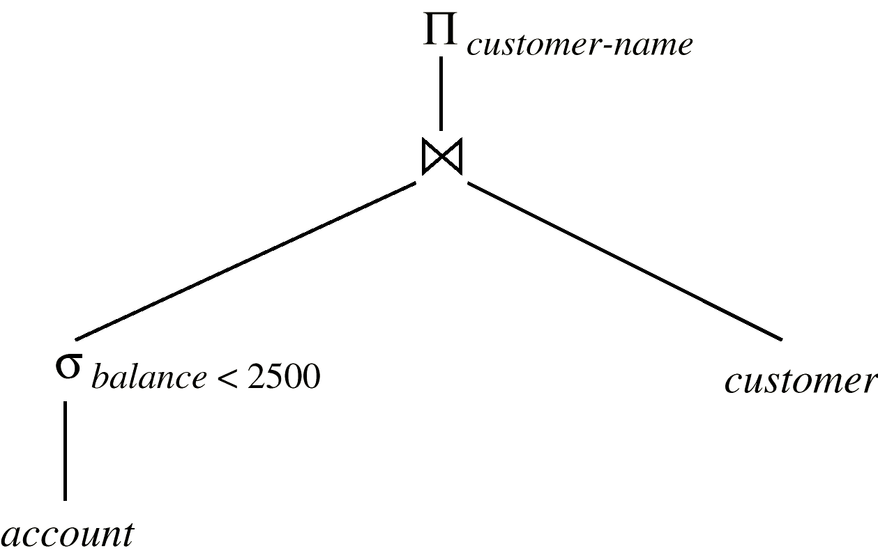
Evaluation of Expressions
Materialization: evaluate one operation at a time, starting at the lowest-level. Use intermediate results materialized into temporary relations to evaluate next-level operations.
E.g., in figure below, compute and store then compute the store its join with customer, and finally compute the projections on customer-name.

Slide 51
Evaluation of Expressions (Cont.)
Pipelining: evaluate several operations simultaneously, passing the results of one operation on to the next.
E.g., in expression in previous slide, don’t store result of – instead, pass tuples directly to the join..
Similarly, don’t store result of join, pass tuples directly to projection.
Much cheaper than materialization: no need to store a temporary relation to disk.
Pipelining may not always be possible – e.g., sort, hash-join.
For pipelining to be effective, use evaluation algorithms that generate output tuples even as tuples are received for inputs to the operation.
Pipelines can be executed in two ways: demand driven and producer driven.

Slide 52
Transformation of Relational Expressions
Generation of query-evaluation plans for an expression involves two steps:
1. generating logically equivalent expressions
2. annotating resultant expressions to get alternative query plans
Use equivalence rules to transform an expression into an equivalent one.
Based on estimated cost, the cheapest plan is selected. The process is called cost based optimization.

Slide 53
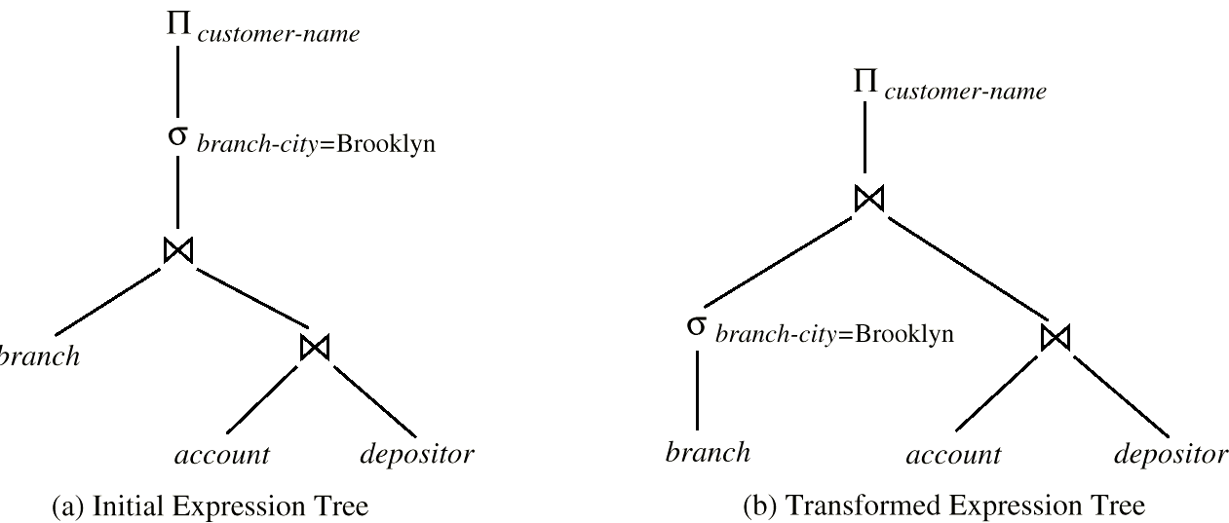
Equivalence of Expressions
Relations generated by two equivalent expressions have the same set of attributes and contain the same set of tuples, although their attributes may be ordered differently.

Slide 54
Equivalence Rules
1. Conjunctive selection operations can be deconstructed into a sequence of individual selections.
2. Selection operations are commutative.
3. Only the last in a sequence of projection operations is needed, the others can be omitted.
4. Selections can be combined with Cartesian products and theta joins.

Slide 55
Equivalence Rules (Cont.)
5. Theta-join operations (and natural joins) are commutative. E_{1 } E₂ = E₂  E₁
6. (a) Natural join operations are associative:
(E₁ E₂) E₃ = E₃ = E₁ (E₂ E₃) (b) Theta joins are associative in the following manner: (E_{1 Θ1} E₂) _{2∧ 3} E₃ = E₁ = E_{1 2∧ 3} (E₂ _{2} E₃) where ₂ involves attributes from only E₂ and E₃.

Slide 56
Equivalence Rules (Cont.)
7. The selection operation distributes over the theta join operation under the following two conditions: (a) When all the attributes in ₀ involve only the attributes of one of the expressions (E₁) being joined. (b) When ₁ involves only the attributes of E₁ and ₂ involves only the attributes of E₂.

Slide 57
Equivalence Rules (Cont.)
8. The projections operation distributes over the theta join operation as follows:
(a) if  involves only attributes from L₁ ∪ L₂:
(b) Consider a join E₁ |x| E₂. Let L₁ and L₂ be sets of attributes from E₁ and E₂, respectively. Let L₃ be attributes of E₁ that are involved in join condition , but are not in L₁ ∪ L₂, and let L₄ be attributes of E₂ that are involved in join condition , but are not in L₁ ∪ L₂.

Slide 58
Equivalence Rules (Cont.)
9. The set operations union and intersection are commutative (set difference is not commutative). E₁ ∪ E₂ = E₂ ∪ E₁ E₁ ∩ E₂ = E₂ ∩ E₁
10. Set union and intersection are associative.
11. The selection operation distributes over ∪, ∩ and –. E.g.: (E₁ – E₂) = (E₁) – (E₂) For difference and intersection, we also have: (E₁ – E₂) = (E₁) – E₂
12. The projection operation distributes over the union operation.
Π_{t}(E₁ ∪ E₂) = (Π_{t}(E₁)) ∪ (Π_{t}(E₂))

Slide 59
Selection Operation Example
Query: Find the names of all customers who have an account at some branch located in Brooklyn. Π_{customer-name(}(σ_{branch-city - “Brooklyn”} (branch (account depositor)))
Transformation using rule 7a. Π_{customer-name} ((σ_{branch-city - “Brooklyn”} (branch)) (account depositor))
Performing the selection as early as possible reduces the size of the relation to be joined.

Slide 60
Selection Operation Example (Cont.)
Query: Find the names of all customers with an account at a Brooklyn branch whose account balance is over $1000. Π_{customer-name(}(σbranch-city - “Brooklyn” ∧ balance > 1000 (branch (account depositor)))
Transformation using join associatively (Rule 6a): Π_{customer-name}((σbranch-city - “Brooklyn” ∧ balance > 1000 (branch (account)) depositor)
Second form provides an opportunity to apply the “perform selections early” rule, resulting in the subexpression
σ_{branch-city - “Brooklyn”} (branch) σ _{balance > 1000} (account)
Thus a sequence of transformations can be useful

Slide 61
Projection Operation Example
Π_{customer-name}((σ_{branch-city - “Brooklyn”} (branch)
(account) depositor)
When we compute
(σ_{branch-city = “Brooklyn”} (branch) account ) we obtain a relation whose schema is: (branch-name, branch-city, assets, account-number, balance)
Push projections using equivalence rules 8a and 8b; eliminate unneeded attributes from intermediate results to get: Π _{customer-name} ((Π _{account-number} ( (σ_{branch-city = “Brooklyn”} (branch) account )) depositor)

Slide 62
Join Ordering Example
For all relations r_{1,} r_{2,} and r₃,
(r₁ r₂) r₃ = r₁ (r₂ r₃ )
If r₂ r₃ is quite large and r₁ r₂ is small, we choose
(r₁ r₂) r₃
so that we compute and store a smaller temporary relation.

Slide 63
Join Ordering Example (Cont.)
Consider the expression
Π_{customer-name} ((σ_{branch-city = “Brooklyn”} (branch)) account depositor)
Could compute account depositor first, and join result with σ_{branch-city = “Brooklyn”} (branch) but account depositor is likely to be a large relation.
Since it is more likely that only a small fraction of the bank’s customers have accounts in branches located in Brooklyn, it is better to compute
σ_{branch-city = “Brooklyn”} (branch) account
first.

Slide 64
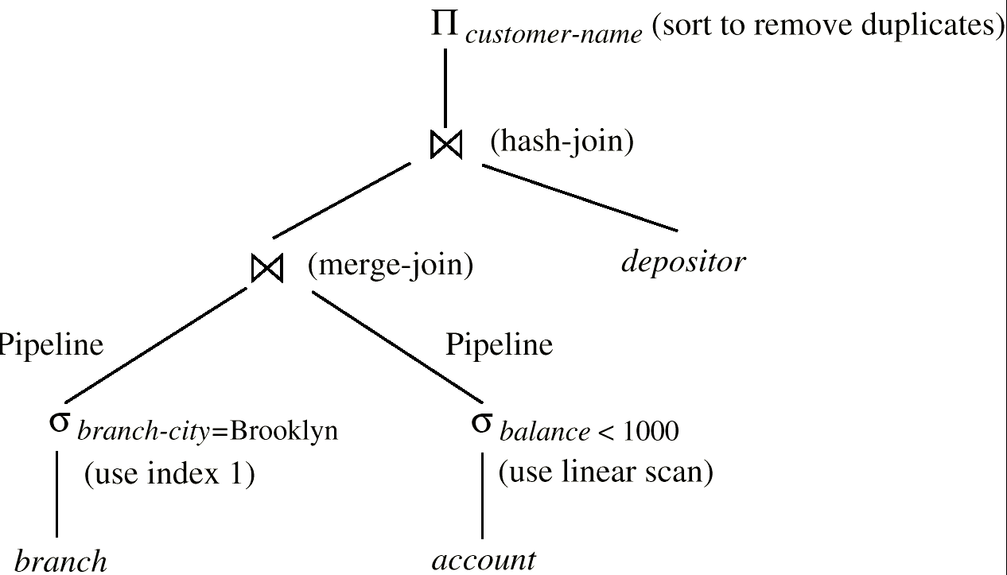
Evaluation Plan
An evaluation plan defines exactly what algorithm is used for each operation, and how the execution of the operations is coordinated.

Slide 65
Choice of Evaluation Plans
Must consider the interaction of evaluation techniques when choosing evaluation plans: choosing the cheapest algorithm for each operation independently may not yield best overall algorithm. E.g.
merge-join may be costlier than hash-join, but may provide a sorted output which reduces the cost for an outer level aggregation.
nested-loop join may provide opportunity for pipelining
Practical query optimizers incorporate elements of the following two broad approaches:
1. Search all the plans and choose the best plan in a cost-based fashion.
2. Uses heuristics to choose a plan.

Slide 66
Cost-Based Optimization
Consider finding the best join-order for r₁ r₂ . . . r_{n}.
There are (2(n – 1))!/(n – 1)! different join orders for above expression. With n = 7, the number is 665280, with n = 10, the number is greater than 176 billion!
No need to generate all the join orders. Using dynamic programming, the least-cost join order for any subset of {r₁, r₂, . . . r_{n}} is computed only once and stored for future use.
This reduces time complexity to around O(3^{n}). With n = 10, this number is 59000.

Slide 67
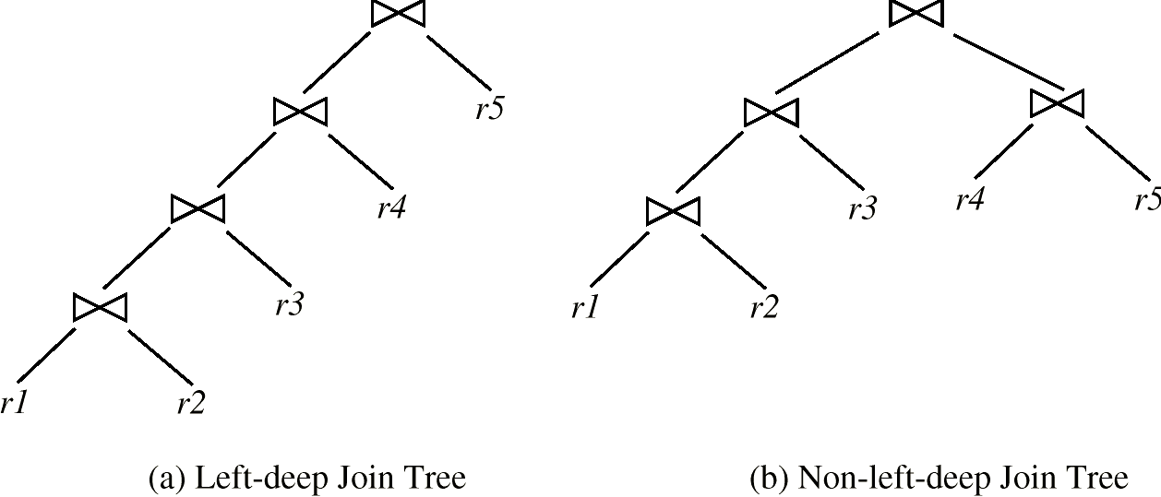
Cost-Based Optimization (Cont.)
In left-deep join trees, the right-hand-side input for each join is a relation, not the result of an intermediate join.
If only left-deep trees are considered, cost of finding best join order becomes O(2^{n})

Slide 68
Dynamic Programming in Optimization
To find best left-deep join tree for a set of n relations:
Consider n alternatives with one relation as right-hand side input and the other relations as left-hand side input.
Using (recursively computed and stored) least-cost join order for each alternative on left-hand-side, choose the cheapest of the n alternatives.
To find best join tree for a set of n relations:
To find best plan for a set S of n relations, consider all possible plans of the form: S₁ (S – S₁) where S₁ is any non-empty subset of S.
As before, use recursively computed and stored costs for subsets of S to find the cost of each plan. Choose the cheapest of the 2^{n} – 1 alternatives.

Slide 69
Interesting Orders in Cost-Based Optimization
Consider the expression (r₁ r₂ r₃) r₄ r₅
An interesting sort order is a particular sort order of tuples that could be useful for a later operation.
Generating the result of r₁ r₂ r₃ sorted on the attributes common with r₄ or r₅ may be useful, but generating it sorted on the attributes common only r₁ and r₂ is not useful.
Using merge-join to compute r₁ r₂ r₃ may be costlier, but may provide an output sorted in an interesting order.
Not sufficient to find the best join order for each subset of the set of n given relations; must find the best join order for each subset, Simple extension of earlier dynamic programming algorithms.

Slide 70
Heuristic Optimization
Cost-based optimization is expensive, even with dynamic programming.
Systems may use heuristics to reduce the number of choices that must be made in a cost-based fashion.
Heuristic optimization transforms the query-tree by using a set of rules that typically (but not in all cases) improve execution performance:
Perform selection early (reduces the number of tuples)
Perform projection early (reduces the number of attributes)
Perform most restrictive selection and join operations before other similar operations.
Some systems use only heuristics, others combine heuristics with partial cost-based optimization.

Slide 71
Steps in typical Heuristics Optimization
1. Deconstruct conjunctive selections into a sequence of single selection operations (Equiv. rule 1.).
2. Move selection operations down the query tree for the earliest possible execution (Equiv. rules 2, 7A, 7b, 11).
3. Execute first those selection and join operations that will produce the smallest relations (Equiv. rule 6).
4. Replace Cartesian product operations that are followed by a selection condition by join operations (Equiv. rule 4a).
5. Deconstruct and move as far down the tree as possible lists of projection attributes, creating new projections where needed (Equiv. rules 3, 8a, 8b, 12).
6. Identify those subtrees whose operations can be pipelined, and execute them using pipelining).

